Slide 1
RUNGTA COLLEGE OF DENTAL SCIENCES & RESEARCH
TITLE OF THE TOPIC-
ORTHODONTIC DIAGNOSIS
DEPARTMENT OF ORTHODONTICS AND DENTOFACIAL ORTHOPAEDICS

Slide 2
Specific learning Objectives
CORE AREAS | DOMAIN | CATEGORY
ESSENTIAL DIAGNOSTIC AID | AFFECTIVE | DESIRE TO KNOW
CASE HISTORY | COGNITIVE | MUST KNOW
ORTHODONTIC STUDY MODELS | PSYCHOMOTOR | NICE TO KNOW
DIAGNOSTIC SET UP | PSYCHOMOTOR | NICE TO KNOW
RECENT ADVANCES | AFFECTIVE | DESIRE TO KNOW

Slide 3
CONTENTS
Introduction
PART – I
Essential diagnostic aids
Supplemental diagnostic aids
CASE HISTORY :
Personal Detail, Chief Complaint, Medical History, Dental history,
Prenatal & Postnatal history, Family history.
General Examination : Body build
Extraoral Examination: Facial form, facial symmetry, facial profile,facial divergence, assessment of posterior jaw relationship, assessment of vertical skeletal relation, evaluation of facial proportion , examination of lips , examination of nose , examination of chin and nasolabial angle
Intraoral examination : Examination of Tongue , palate , gingiva , frenal attachment , tonsils & adenoids , Assessment of dentition , Functional examination , assessment of postural rest position and inter-occlusal clearance , methods used to record postural rest position , methods to measure inter-occlusal clearance , Evaluation of path of closure , assessment of repiration , examination of TMJ , Evaluation of Swallow & speech

Slide 4
PART – II
Orthodontic study models
Diagnostic setups
PART – III
Supplemental diagnostic aids : Facial photographs as diagnostic aids , Electromyography , Radiographs in Orthodontics
Recent advances in Orthodontics
Summary

Slide 5
EXAMINATION OF LIPS
◆ The upper lip covers the entire labial surface of upper anteriors except the incisal 2-3 mm
◆ The lower lip covers the entire labial surface of lower anteriors and 2-3 mm of incisal edge of upper anteriors.

Slide 6
CLASSIFICATION OF LIPS
◆ Competent lip-the lips are in slight contact when musculature is relaxed.

Slide 7
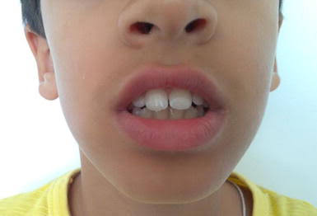
◆ INCOMPETENTLIPS-theyaremorphologically short lips which do not form a lip seal in a relaxed state.
◆ The lip seal can only be achieved by active contraction of perioral and mentalis muscle.

Slide 8
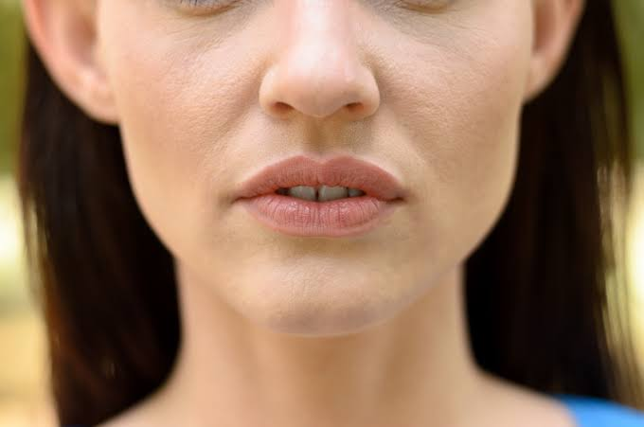
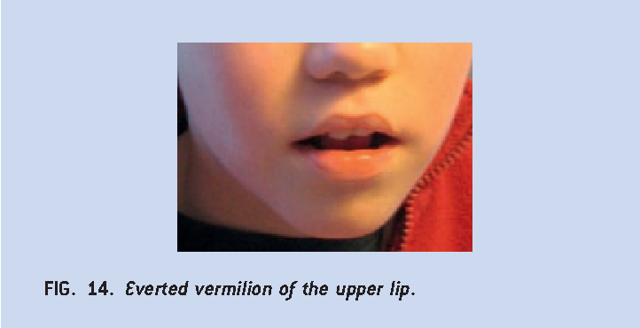
◆ POTENTIALLY INCOMPETENT LIP-they are normal lips that fails to form a lip seal due to proclaimed upper incisor.
◆ EVERTED LIP-they are hypertrophied lips with weak muscular tonicity.

Slide 9
EXAMINATION OF THE NOSE
◆ The nose to a large extend contributes to the esthetic appearance of a face.
◆ Nose size-normally the nose is one third of the total facial height.
◆ Nasal contour-the shape of the nose can be straight, convex or crooked as a result of nasal in juries.
◆ Nostrils-they are oval and should be bilaterally symmetrical. Stenosis of the nostrils may indicate impaired nasal breathing.

Slide 10
EXAMINATION OF CHIN
◆ MENTOLABIAL SULCUS-concavity seen below the lower lip.
Deep mentolabial sulcus is seen in class11,divison 1 malocclusion.
◆ MENTALIS ACTIVITY-normaIly mentalis is not active at rest.
◆ Hyperactive mentalis is seen in class II divison 1 cases.
◆ CHIN POSITION AND PROMINENCE-prominent chin is usually associated with class III malocclusion.
DEEP MENTOLABIAL SULCUS AND HYPERACTIVE MENTALIS SEEN IN CLASS II DIVISON 1 MALOCCLUSION

Slide 11
NASOLABIAL ANGLE
◆ It is the angle formed between lower border of the nose and a line connecting the intersection of nose and the upper lip with the tip of the lip.
◆ This angle is normally 110 degree.
◆ It reduces in patients with proclaimed upper
Incisors prognathic maxilla.

Slide 12
INTRA-ORAL EXAMINATION
Examination of tongue
◆ Abnormalities of tongue can upset the muscle balance and equilibrium leading to malocclusion.
◆ A patient whose tongue can reach the tip of the nose is said to have a long nose.
◆ The lingual frenum should be examined for tongue tie.

Slide 13
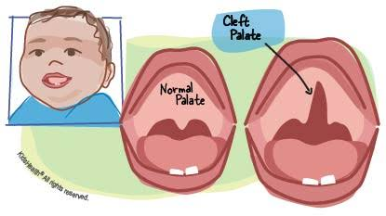
EXAMINATION OF THE PALATE
◆ Palate should be examined for the following findings;
Dolicofacial patients have deep palate.
Presence of swellings in the palate
Mucosal ulcerations and indentations are a feature of traumatic deep bite.
Presence of cleft in the palate.
The third rugae is usually in line with canines. This is useful in the assessment of maxillary anterior proclination.

Slide 14
EXAMINATION OF GINGIVA
◆ Gingiva should be examined for
Inflammation
Recession
Mucogingival lesions
◆ Poor oral hygeine is associated with anterior marginal gingivitis.
◆ Anterior gingivitis common in mouth breathers due to dryness of mouth caused by open lip posture.

Slide 15
EXAMINATION OF FRENAL ATTACHMENTS
◆ The maxillary labial frenum sometimes be thick fibrous and attached relatively low.
◆ This may lead to midline diastema.
◆ Abnormal frenal attachment are diagnosed by blench test.

Slide 16
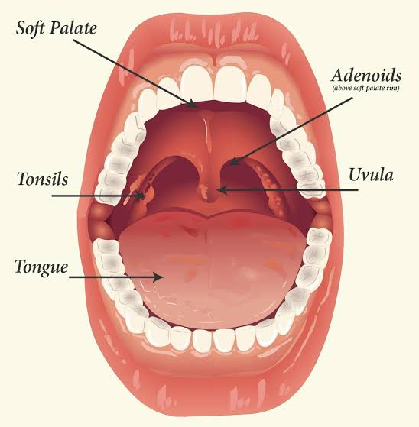
EXAMINATION OF TONSILS AND ADENOIDS
◆ Abnormaly inflamed tonsils cause alterations in tongue and jaw posture there by upsetting the oro-facial balance leading to malocclusion.

Slide 17
ASSESSMENT OF DENTITION
Dental system is examined for ;
Teeth present in the oral cavity
Teeth unerupted
Teeth missing
Teeth erupted and not erupted
Presence of caries, restorations ,malocclusions, hypoplasia, wear and
dislocation.

Slide 18
Check for the occlusion based on ANGLES CLASS I ,II ,III.
Record overbite over jet
Check for cross bite
Individual tooth irregularities such as rotation, displacement intrusion and extrusion are noted.
Check arch form.

Slide 19
FUNCTIONAL EXAMINATION
◆ It is now established that normal function of
stomatognathic system promotes normal growth
and development of oro-facial complex.
◆ The functional examination should include the
following;
Assessment of postural rest position and inter occlusal space.
Path of closure
Assessment of respiration
Assessment of TMJ
Examination of swallowing
Examination of speech.

Slide 20
ASSESSMENT OF POSTURAL REST POSITION AND INTER-OCCLUSAL CLEARANCE.
◆ The postural rest position of the mandible at which the muscles that closes the jaw and those that open them are, in state of minimal contraction to maintain the posture of mandible.
◆ At postural rest position, a space exists between the upper and lower jaws.
◆ This space is known as FREEWAY SPACE.
◆ FREEWAY SPACE is 3mm in canine region.

Slide 21
METHODS USED TO RECORD THE POSTURAL REST POSITION
PHONETIC METHOD; the patient is asked to repeat some consonants “m or c’’ or repeat a word like Mississippi.
◆ The mandible returns to postural rest position 1-2 seconds after the exercise.
◆ The patient is told not to change the jaw, lip or tongue position after phonation, as the dentist parts the lips to study interocclusal space.

Slide 22
COMMAND METHOD
◆ The patient is asked to perform certain functions such as swallowing.
◆ The mandible tends to return to rest position following this act.

Slide 23
Non command method
◆ The patient is observed as he speaks or swallows.
The patient is no aware that he is being examined.
◆ This is usually being carried out by talking about topics unrelated to the patient while carefully observing him or not.

Slide 24
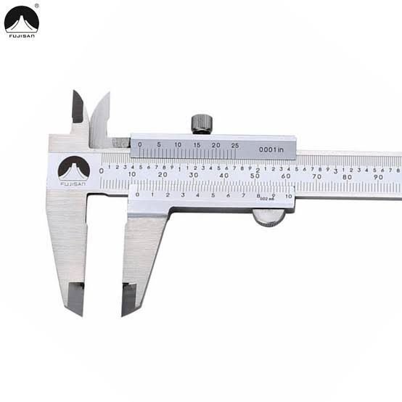
METHODS TO MEASURE INTER-OCCLUSAL CLEARANCE
◆ Vernier calipers can be used directly in the patient’s mouth in the canine or Incisal region to measure freeway space.
◆ This is direct intra oral method.

Slide 25
EVALUATION OF PATH OF CLOSURE
The path of closure is the movement of mandible from the rest position to habitual occlusion .
Forward path of closure:a forward path of closure occurs in patients with mild skeletal and prenormalcy or edge to edge incisor contact. In such patients ,the mandible is guided to a more forward position to allow the mandibular incisors to go labial to the upper incisors.
Backward path of closure: class 11 ,division 2 exhibit premature incisor contact due to retroclined maxillary incisors. Thus the mandible is guided posteriorly to establish occlusion
Lateral path of closure : lateral deviation of mandible to left or right side is associated with occlusal prematurities and a narrow maxillary arch.

Slide 26
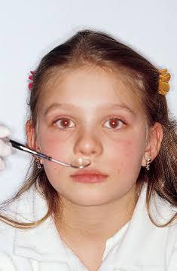
ASSESSMENT OF RESPIRATION
Humans may exhibit three types of breathing: nasal ,oral and
oro-nasal
Test to diagnose the mode of respiration:
Mirror test : a double sided mirror is held between the nose and the mouth .fogging on the nasal side of the mirror indicates nasal breathing while fogging towards oral side indicates oral breathing
Cotton test : a butterfly shaped cotton piece is placed over the upper lip below the the nostrils . if the cotton flutters down indicates nasal breathing. this test is used to determine the unilateral nasal blockage.
.

Slide 27
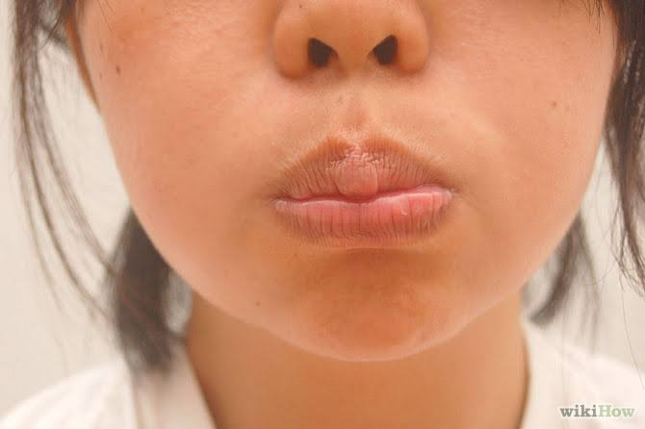
WATER TEST - the patient is asked to fill his mouth with water and retain it for a long period of time .while nasal breathers accomplish this with ease , mouth breathers find it difficult task.

Slide 28
Observation : in nasal breathers the external nares dilate during inspiration .in mouth breathers ,there is either no change in the external nares or they may constrict during inspiration
EXAMINATION OF T.M.J.
The functional examination should routinely include auscultation and palpation of temporomandibular joint and musculature associated with mandibular opening.
The patient should be examined for the symptoms of joint problems like clicking, crepitus , pain of masticatory muscles , limitation of jaw movement , hyper-mobility and morphological abnormalities.
The maximum mouth opening is determined by measuring the distance between the maxillary and mandibular incisal edges with mouth wide open.
The normal inter incisal distance is 40- 45 mm.

Slide 29
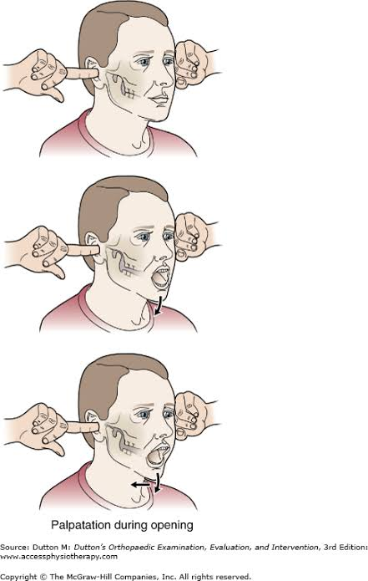

Slide 30
EVALUVATION OF SWALLOWING
In a new born, tongue is relatively large and protrudes between the gumpads and takes part in establishing the lip seal .this kind of swallow is called infantile swallow and is seen till one and half to two year s of age .
Infantile swallow is replaced by mature swallow as the buccal teeth start erupting. The persistence of infantile swallowing can cause malocclusion .thus the swallowing pattern of the individual should be examined.
The persistence of the infantile swallow is indicated by the presence of the following features:
Protrusion of the tip of tongue
Contraction of perioral muscles during swallowing
No contact at the molar region during swallowing.

Slide 31
SPEECH
..Certain malocclusions may cause defects in speech due to interference with the movement of tongue and lips
.this should be observed while talking
with the patient .
..The patient can be asked to read out from a book or asked to count from 1-20 while observing the speech.
..Patients having tongue thrust habit tend to lisp while cleft palate patients may have a nasal tone.

Slide 32
ORTHODONTIC STUDY MODELS
Orthodontic study models are accurate plaster reproductions of teeth and their surrounding soft tissues .that are essential diagnostic aid that make it possible to study the arrangement of teeth and the occlusion from all directions .
Uses of study model include:
They enable study of occlusion from all aspect
Enable accurate measurements to be made in dental arch.they help in the measurement of arch length, arch width
,and tooth size
Help in assessment of treatment progress by dentist as well as by
patient
Help in assessing the nature and severity of malocclusion
Helpful in motivation of patient and to explain the treatment plan as well as progress to patient and parents
Makes it possible to stimulate treatment procedures on cast
such as mock surgery
Useful to transfer records in case patient is treated by another clinician.

Slide 33
ORTHODONTIC STUDY MODELS

Slide 34
GNATHOSTATIC MODELS
They are orthodontic study models where the base of the maxillary cast is trimmed to correspond to the Frankfort horizontal plane.
DIAGNOSTIC SET UP
It was first propose by H.D. kesling
Diagnostic set up is made from an extra set of trimmed and polished study models .the individual teeth and their associated alveolar processes are sectioned off and replaced on the model base in the desired positions .the diagnostic set up thus help in simulating the various tooth movements that are planned for patients.

Slide 36
USES OF DIAGNOSTIC SET UP
Useful in visualizing and testing the effect of complex tooth movements and extractions on the occlusion
Patient can be motivated by simulating the various corrective procedures in the cast
Tooth size- arch length discrepancies can be visualized
PROCEDURE
1. The cast is cut using a fretsaw blade to separate the individual teeth.
2.A horizontal cut is made 3mm apical to gingival margin
Vertical cuts are made to separate the individual teeth.
The individual teeth are set in desired position using a red wax.
◆
◆

Slide 37
SUMMARY
Orthodontic examination and diagnosis start first with formal and
informal meeting with child and parents.
A detailed history is followed by a detailed, intricate examination of physical growth, face,soft tissues and oral cavity, including functions of stomatognathic
systems.
A close and diligent clinical study evaluation of malocclusion and
functional examination is a critical component of orthodontic diagnosis.
A detailed examination cannot be done in a hurry and
would require each of the listed components to be recorded and
evaluated for its possible impact on oral health and orthodontic
treatment.
The clinical examination is followed by making required
records and investigations leading to a comprehensive diagnosis and
treatment plan.

Slide 38
REFERENCES
Textbook of Orthodontics – Gurkeerat Singh, Jaypee Brothers; 2nd Edition
Orthodontics – The Art and Science, S.I Bhalajhi, AryaMedi Publishing; 7th Edition
Textbook of Orthodontics – Sridhar Premkumar, Elsevier; 1st Edition
Orthodontics: Diagnosis and Management of Malocclusion and Dentofacial Deformities – O.P Kharbanda, Elsevier; 1st Edition

Slide 39
Question & Answer Session

